Slide 1
Java 4 WEB
Lesson 8 – Home tasks overview

Slide 2
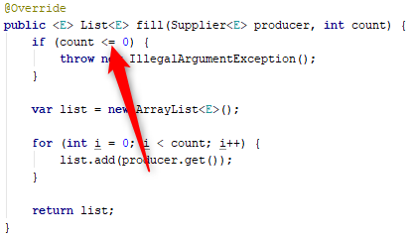
1. Why zero is illegal argument value?

Slide 3
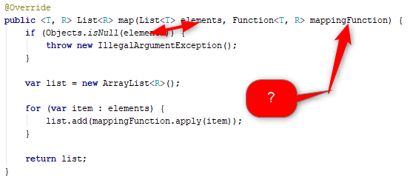
2. Partial validation
Notes:
Why only some arguments are validated?
It cane be removed (or completed and covered by tests)

Slide 4
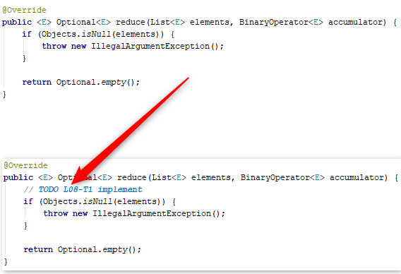
3. Use TODO for unimplemented code

Slide 5
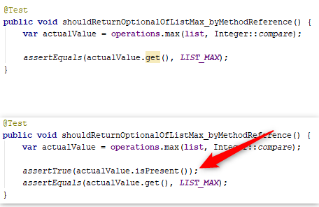
4. Unsafe optional unpack
Notes:
Use check for value presence before unpack

Slide 6
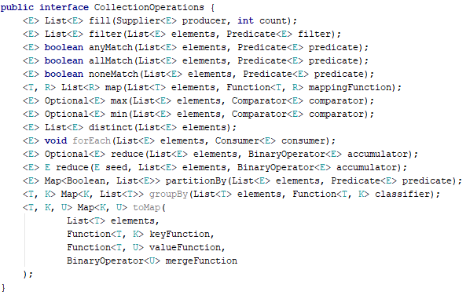
5. Format code

Slide 7
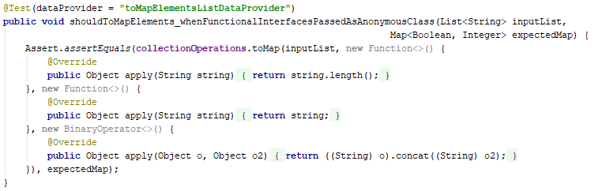
5. Format code
Notes:
Test should be read by three blocks
Given – When - Then

Slide 8
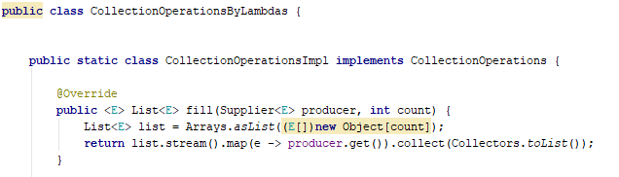
6. Avoid inner classes

Slide 9
7. Do not use streams (incorrectly)

Slide 10
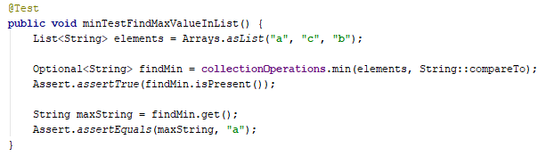
8. Confusing naming

Slide 11
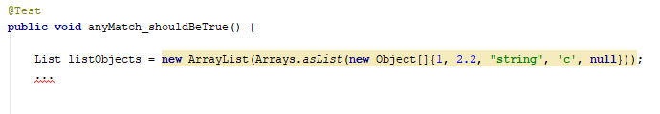
9. Use generics
Notes:
Why did not use generics?

Slide 12


10. KISS
Notes:
Take care on IDEA warnings

Slide 13
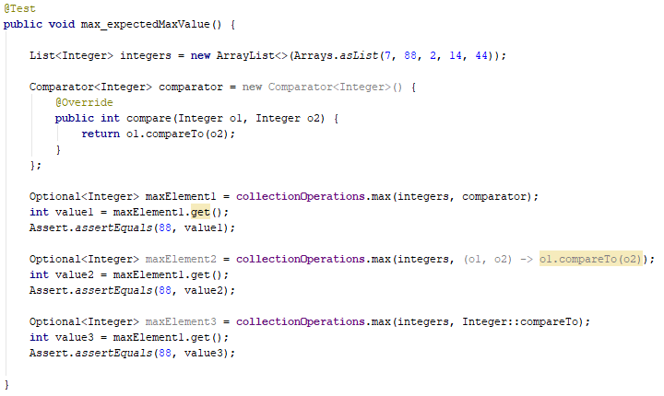
11. Be careful
Notes:
What is wrong with assertions?

Slide 14
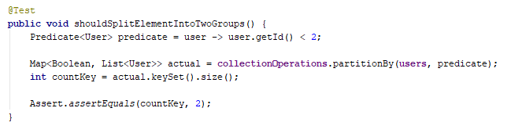
12. Assert not only size but content (order?)
Notes:
Be careful, assertEquals for collections and maps check also collections order, be aware (sometimes we do not need order equality check but only content check)

Slide 15
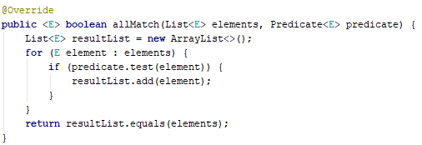
13. Non optimal implementation

Slide 16
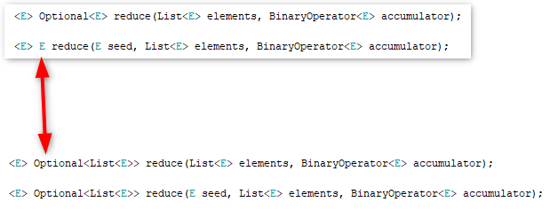
14. Follow rules
Notes:
Do not modify home task description

Slide 17
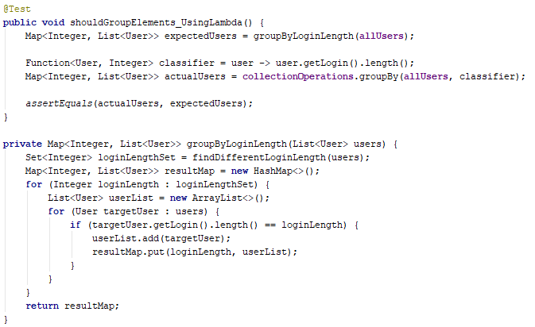
15. Do not write algorithms in unit test
Notes:
Expected and Actual should be compared by value and result of method but not as two results of methods
Do not duplicate logic from main in test. You test it but not
Code reuse in test is usually bad practice

Slide 18
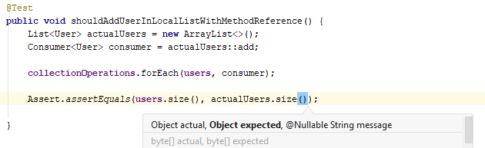
16. Use correct arguments order

Slide 19
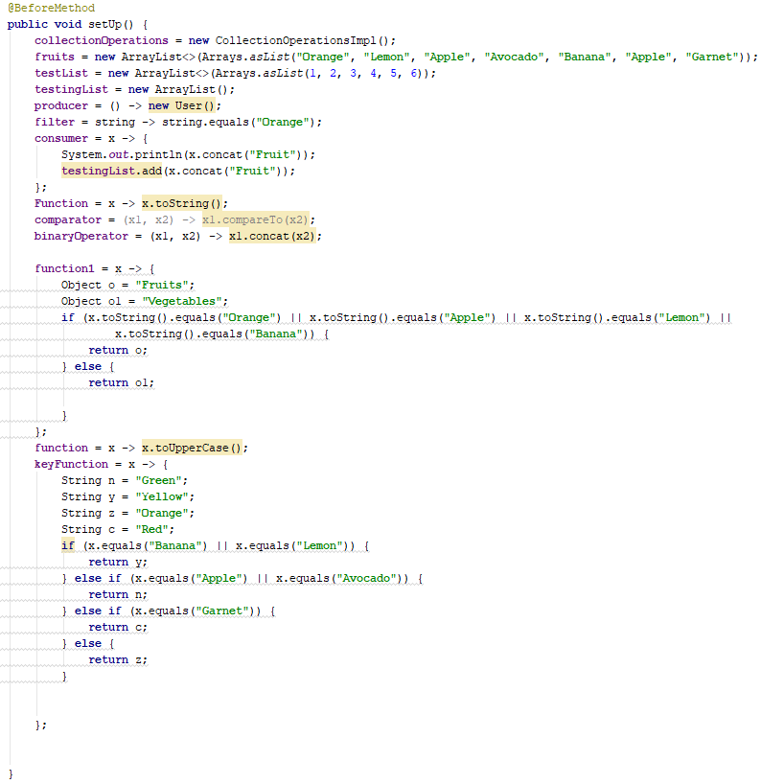
17. Guess what is tested

